Slide 1
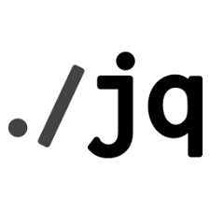

JSON Array Slicing using Jq Command
NarendraP
Jq Command for Bash Shell Scripting

Slide 2
JSON Array Slicing:
Slicing of Array is nothing but getting sub-array from a given array
Syntax:
jq ‘.[startIndex:endIndex]’ filename
jq ‘.[:endIndex]’ filename
Jq. ‘[startIndex:]’ fileName
Jq is a command-line utility to parse JSON Data

Slide 3
Thank you

